Slide 1
Spring DAO
Andy Chen

Slide 2
Spring JDBC
What are these?
JDBC
Spring JDBC
Spring Data JDBC (*)
Hibernate
Spring Data JPA
Spring Data

Slide 3
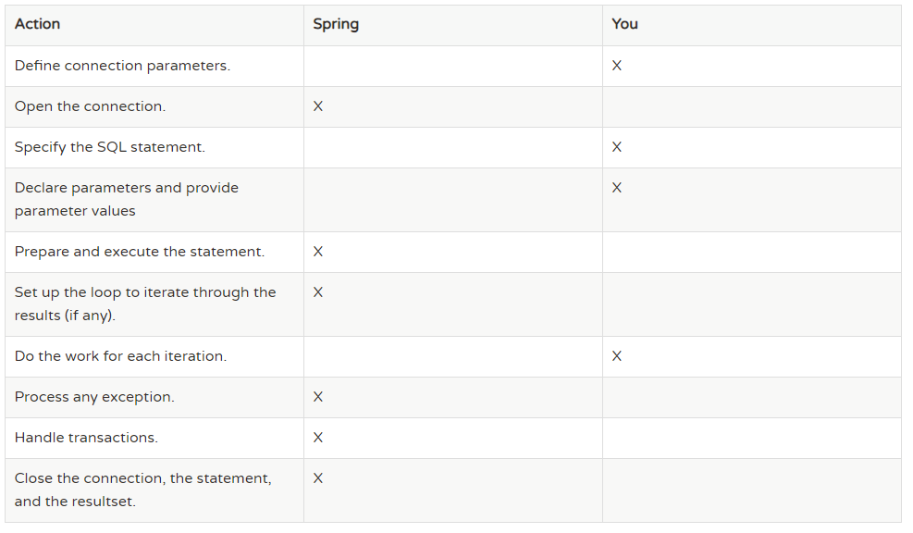
Why Spring JDBC?

Slide 4
Diagram of components
JDBC Operations
Conn
To
DB
table
Service
Procedure
DataSource
CRUD Batch
For table and SP
Transaction

Slide 5
Data Access - CRUD
JdbcTemplate
NamedParameterJdbcTemplate
SimpleJdbcInsert & SimpleJdbcCall
MappingSqlQuery, SqlUpdate,
StoredProcedure

Slide 6
CRUD
Basic CRUD Operations
JdbcTemplate
NamedParameterJdbcTemplate
SimpleJdbcInsert
SimpleJdbcCall
Batch Process
Stored Procedure and function
Notes:
https://www.logicbig.com/tutorials/spring-framework/spring-data-access-with-jdbc/spring-call-stored-procedure.html
FOR STORED PROCEDURES

Slide 7



JdbcTemplate
Select(“query”, “queryForObject”, “queryForList”)
Insert/Update/Delete (“update”)
DDL (“execute”)
Notes:
jdbcTemplate is thread-safe

Slide 8
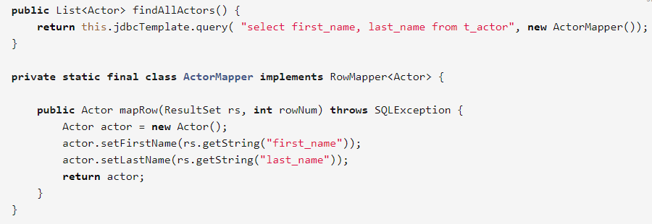
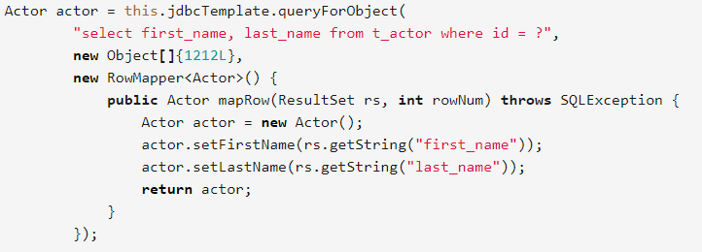
JdbcTemplate.“select”
JPA

Slide 9
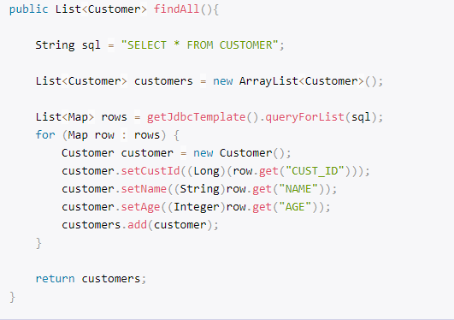
JdbcTemplate.“select” (queryForList)

Slide 10
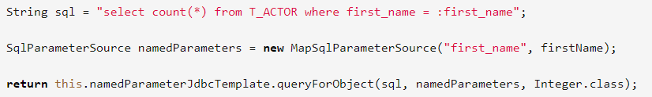
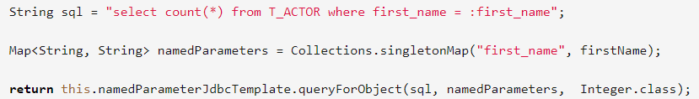
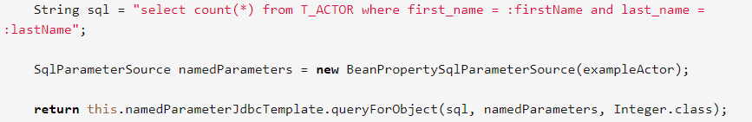
NamedParameterJdbcTemplate
Map input parameters instead of traditional “?”
Notes:
exampleActor has to be set with values
exampleActor can have fields more than just firstName and lastName

Slide 11
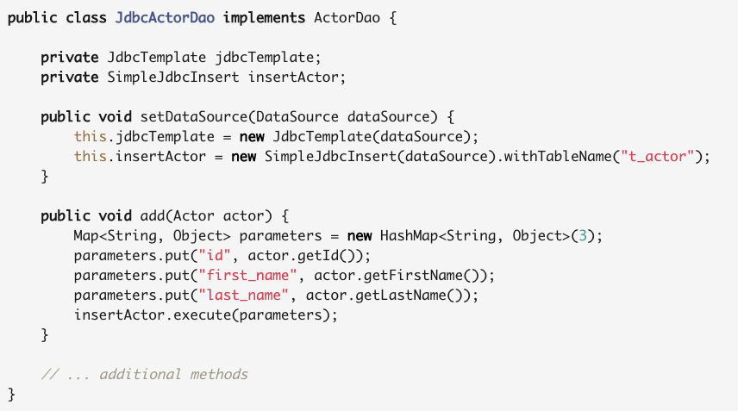
* SimpleJdbcInsert
Notes:
Execute takes only a map and the map key has to be the same as the table columns..
It can also work with SqlParameterSource and MapSqlParameterSource as input just as in NamedParameterJdbcTemplate

Slide 12
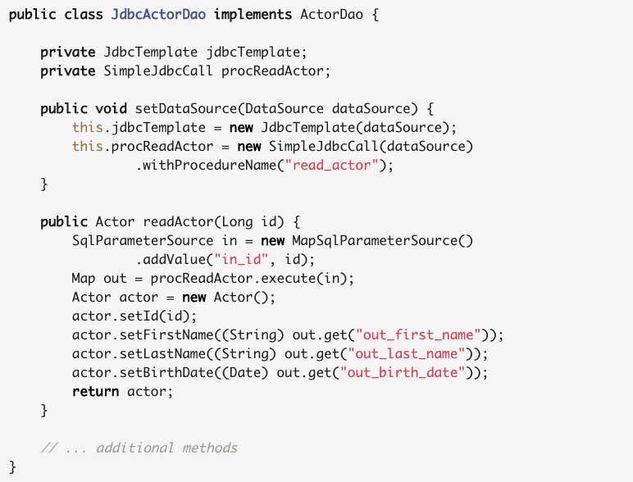
* Stored Procedure: SimpleJdbcCall

Slide 13
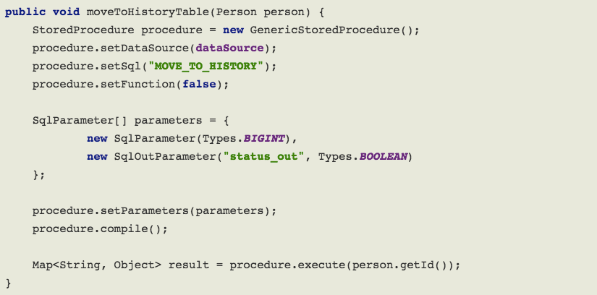
* Stored Procedure: StoredProcedure
Notes:
StoredProcedure is an abstract class

Slide 14
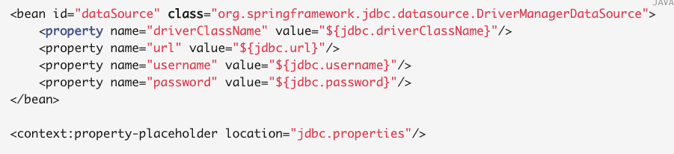
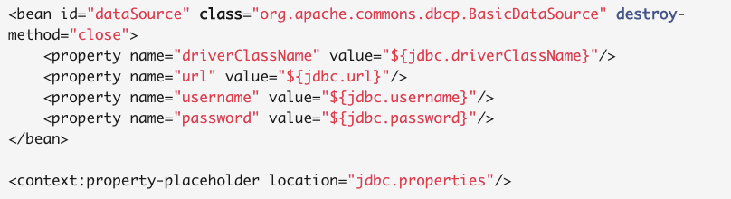
Data Source
Notes:
How to call??
Which one to use?

Slide 15
Spring Data
Spring Data JPA, Hibernate, MyBatis etc??

Slide 16
Spring Transaction Management

Slide 17
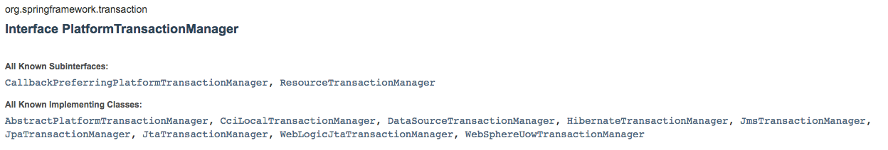
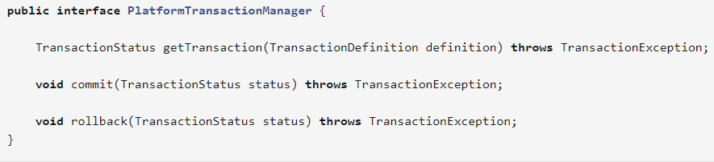
What Spring Transaction?
Global Transaction & Local Transaction
How does Spring resolve the disadvantages of them?
PlatformTransactionManager
Notes:
3 things: getTransaction(), commit(), rollback()

Slide 18
What does Spring tx do? How does Spring tx do it?
Determine commit and rollback
Handle exceptions – using AOP
Declarative Transaction Management
XML
Annotation
Programmatic Transaction Management
Question: Which one to use?

Slide 19
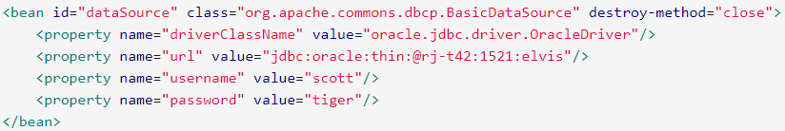
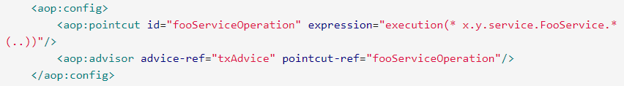
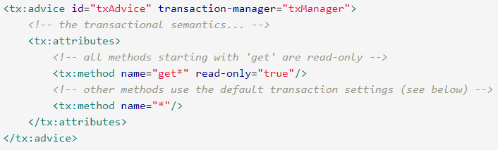
Declarative TX management --- XML
1. Define Data Source
2. Platform-
TransactionManager
uses datasource
3.Use AOP to define
pointcut
4. Define how Spring tx
Management be applied
To pointcut

Slide 20
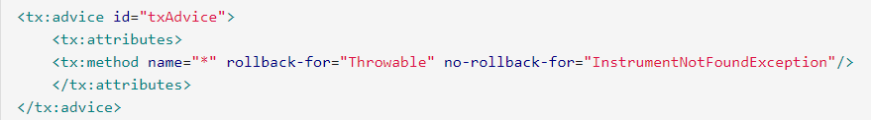

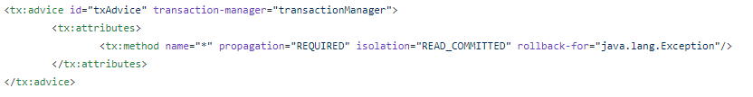
<tx:advice>

Slide 21
Declarative TX management --- Annotation
1. Define Data Source
2. Platform-
TransactionManager
uses datasource
3.Mark “annotation-
Driven”

Slide 22
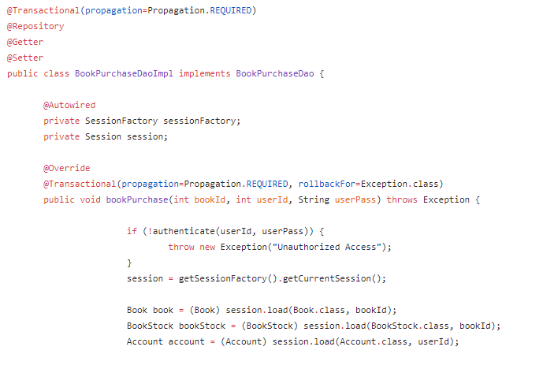
Declarative TX management --- Annotation

Slide 23
Propagation
Isolation
REQUIRED: Must run in a transaction, create new if no transaction exist
REQUIRED_NEW: Always create a new transaction
SUPPORTS: Run in current transaction or no transaction is needed
NOT_SUPPORTED: do not run in a transaction
MANDATORY: Must run in a transaction or an exception will be thrown
Default: Follow underlying database
READ_UNCOMMITTED: Can read uncommitted data
READ_COMMITTED: Only read committed data

Slide 24
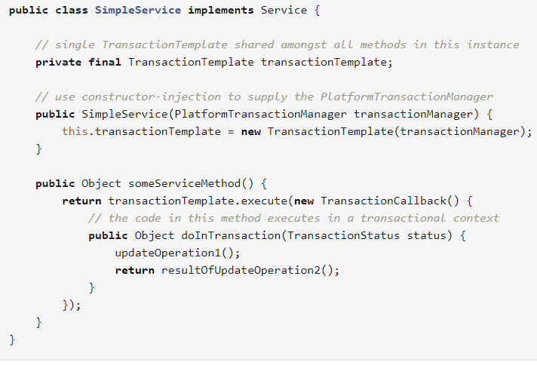
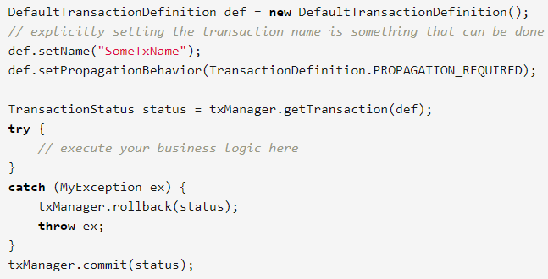
Programmatic tx management
Use “TransactionTemplate” use default “PlatformTransactionManager”

Slide 25
Example – End of Spring DAO

